Slide 1
Wazuh
YD Chiang
2023/12/24

Slide 2
Install Required Software
Install SSH sudo apt-get install ssh
Install Docker sudo apt install docker.io
Install Docker-compose sudo apt install docker-compose
Add user to docker group (輸入 docker 指令前不用加 sudo) sudo usermod -aG docker wazuh
Check System Information
wazuh@wazuh-vm:~$ lsb_release -a
wazuh@wazuh-vm:~$ docker version
wazuh@wazuh-vm:~$ docker-compose version
wazuh@wazuh-vm:~$ docker versoin
Command 'docker' not found, but can be installed with:
sudo snap install docker # version 20.10.24, or
sudo apt install podman-docker # version 3.4.4+ds1-1ubuntu1.22.04.2
sudo apt install docker.io # version 24.0.5-0ubuntu1~22.04.1
See 'snap info docker' for additional versions.
wazuh@wazuh-vm:~$ docker-compose version
Command 'docker-compose' not found, but can be installed with:
sudo snap install docker # version 20.10.24, or
sudo apt install docker-compose # version 1.29.2-1
See 'snap info docker' for additional versions.
wazuh@wazuh-vm:~$ lsb_release -a
No LSB modules are available.
Distributor ID: Ubuntu
Description: Ubuntu 22.04.3 LTS
Release: 22.04
Codename: jammy

Slide 3
Install wazuh (1)
Change user to root wazuh@wazuh-vm:~$ sudo -s
Enter into HOME directory root@wazuh-vm:/home/wazuh# cd
Clone wazuh repository root@wazuh-vm:~# git clone https://github.com/wazuh/wazuh-docker.git -b v4.7.1
Enter into the single-node directory root@wazuh-vm:~# cd wazuh-docker/single-node/ root@wazuh-vm:~/wazuh-docker/single-node# ll
Execute the following command to get the desired certificates: root@wazuh-vm:~/wazuh-docker/single-node# docker-compose -f generate-indexer-certs.yml run --rm generator
Cloning into 'wazuh-docker'...
remote: Enumerating objects: 11923, done.
remote: Counting objects: 100% (1426/1426), done.
remote: Compressing objects: 100% (466/466), done.
Receiving objects: 53% (6424/11923), 106.00 MiB | 3.77 MiB/s
total 28
drwxr-xr-x 3 root root 4096 Dec 24 22:43 ./
drwxr-xr-x 8 root root 4096 Dec 24 22:40 ../
drwxr-xr-x 5 root root 4096 Dec 24 22:40 config/
-rw-r--r-- 1 root root 4282 Dec 24 22:40 docker-compose.yml
-rw-r--r-- 1 root root 292 Dec 24 22:40 generate-indexer-certs.yml
-rw-r--r-- 1 root root 868 Dec 24 22:40 README.md

Slide 4
Install wazuh (2)
Creating network "single-node_default" with the default driver
Pulling generator (wazuh/wazuh-certs-generator:0.0.1)...
0.0.1: Pulling from wazuh/wazuh-certs-generator
edaedc954fb5: Pulling fs layer
573f4d11a520: Pulling fs layer
8f200922197d: Downloading [=======================================> ] 721B/9 edaedc954fb5: Downloading [> ] 277.8kB/2 7.51MB22197d: Download complete
edaedc954fb5: Downloading [=> ] 838.9kB/2 7.51MB
edaedc954fb5: Downloading [==> ] 1.117MB/2 7.51MB
edaedc954fb5: Downloading [==> ] 1.404MB/2 edaedc954fb5: Downloading [===> ] 1.683MB/2 7.51MB
573f4d11a520: Downloading [==> ] 1.961MB/3 8.09MB
edaedc954fb5: Pull complete
573f4d11a520: Pull complete
8f200922197d: Pull complete
55a86de68c5c: Pull complete
Digest: sha256:ea8b03a68be67bae0e164d82b232eae54dd132c2aacd8d3118ba8705df9364a4
Status: Downloaded newer image for wazuh/wazuh-certs-generator:0.0.1
Creating single-node_generator_run ... done
The tool to create the certificates exists in the in Packages bucket
24/12/2023 14:47:42 INFO: Admin certificates created.
24/12/2023 14:47:43 INFO: Wazuh indexer certificates created.
24/12/2023 14:47:43 INFO: Wazuh server certificates created.
24/12/2023 14:47:43 INFO: Wazuh dashboard certificates created.
Moving created certificates to the destination directory
Changing certificate permissions
Setting UID indexer and dashboard
Setting UID for wazuh manager and worker
root@wazuh-vm:~/wazuh-docker/single-node#

Slide 5
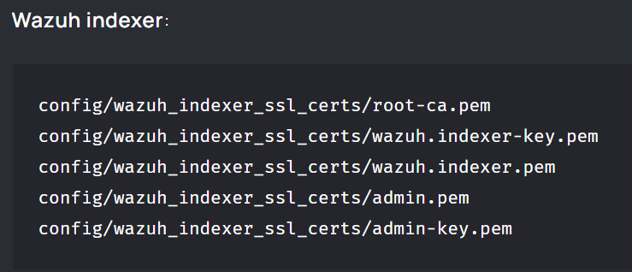
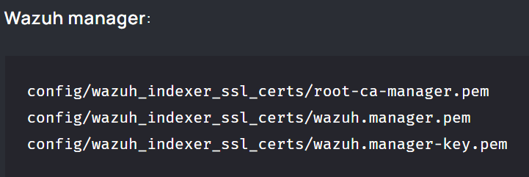
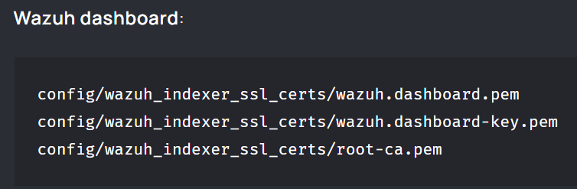
Install wazuh (3)
This saves the certificates into the config/wazuh_indexer_ssl_certs directory
root@wazuh-vm:~/wazuh-docker/single-node/config/wazuh_indexer_ssl_certs# ll
total 56
dr-x------ 2 root root 4096 Dec 24 22:47 ./
drwxr-xr-x 6 root root 4096 Dec 24 22:47 ../
-r-------- 1 wazuh wazuh 1704 Dec 24 22:47 admin-key.pem
-r-------- 1 wazuh wazuh 1119 Dec 24 22:47 admin.pem
-r-------- 1 wazuh wazuh 1704 Dec 24 22:47 root-ca.key
-r-------- 1 systemd-resolve systemd-journal 1704 Dec 24 22:47 root-ca-manager.key
-r-------- 1 systemd-resolve systemd-journal 1204 Dec 24 22:47 root-ca-manager.pem
-r-------- 1 wazuh wazuh 1204 Dec 24 22:47 root-ca.pem
-r-------- 1 wazuh wazuh 1704 Dec 24 22:47 wazuh.dashboard-key.pem
-r-------- 1 wazuh wazuh 1261 Dec 24 22:47 wazuh.dashboard.pem
-r-------- 1 wazuh wazuh 1704 Dec 24 22:47 wazuh.indexer-key.pem
-r-------- 1 wazuh wazuh 1257 Dec 24 22:47 wazuh.indexer.pem
-r-------- 1 wazuh wazuh 1704 Dec 24 22:47 wazuh.manager-key.pem
-r-------- 1 wazuh wazuh 1257 Dec 24 22:47 wazuh.manager.pem

Slide 6
Install wazuh (4)
Start the Wazuh single-node deployment using docker-compose: root@wazuh-vm:~/wazuh-docker/single-node/config/wazuh_indexer_ssl_certs# cd ~/wazuh-docker/single-node/ root@wazuh-vm:~/wazuh-docker/single-node# docker-compose up –d
root@wazuh-vm:~/wazuh-docker/single-node# docker ps -a
CONTAINER ID IMAGE COMMAND CREATED STATUS PORTS NAMES
4c7a77af206b wazuh/wazuh-dashboard:4.7.1 "/entrypoint.sh" 15 minutes ago Up 15 minutes 443/tcp, 0.0.0.0:443->5601/tcp, :::443->5601/tcp single-node_wazuh.dashboard_1
4c27c607e89f wazuh/wazuh-indexer:4.7.1 "/entrypoint.sh open…" 15 minutes ago Up 15 minutes 0.0.0.0:9200->9200/tcp, :::9200->9200/tcp single-node_wazuh.indexer_1
a0aba21835ff wazuh/wazuh-manager:4.7.1 "/init" 15 minutes ago Up 15 minutes 0.0.0.0:1514-1515->1514-1515/tcp, :::1514-1515->1514-1515/tcp, 0.0.0.0:514->514/udp, :::514->514/udp, 0.0.0.0:55000->55000/tcp, :::55000->55000/tcp, 1516/tcp single-node_wazuh.manager_1

Slide 7
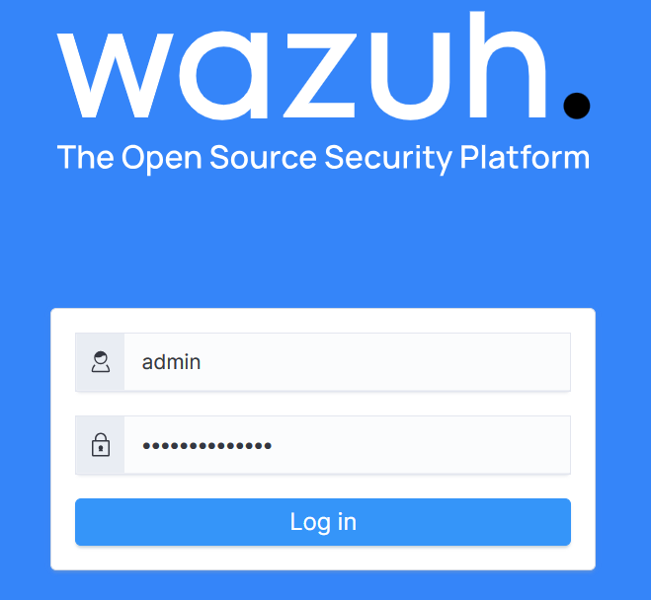
Login Wazuh
https://192.168.100.150/
Default user/password:
admin/SecretPassword

Slide 8
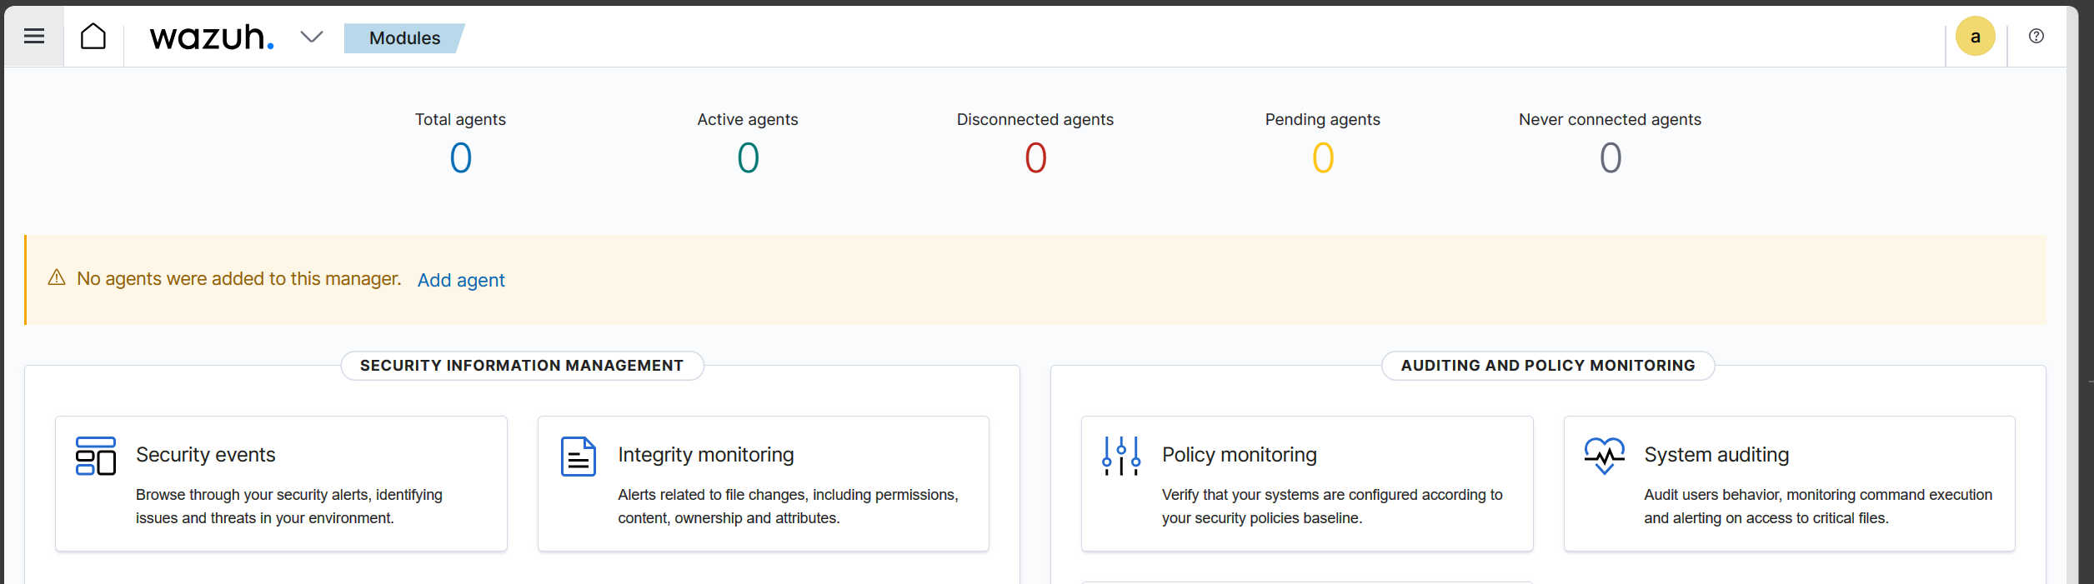
Add Agent

Slide 9
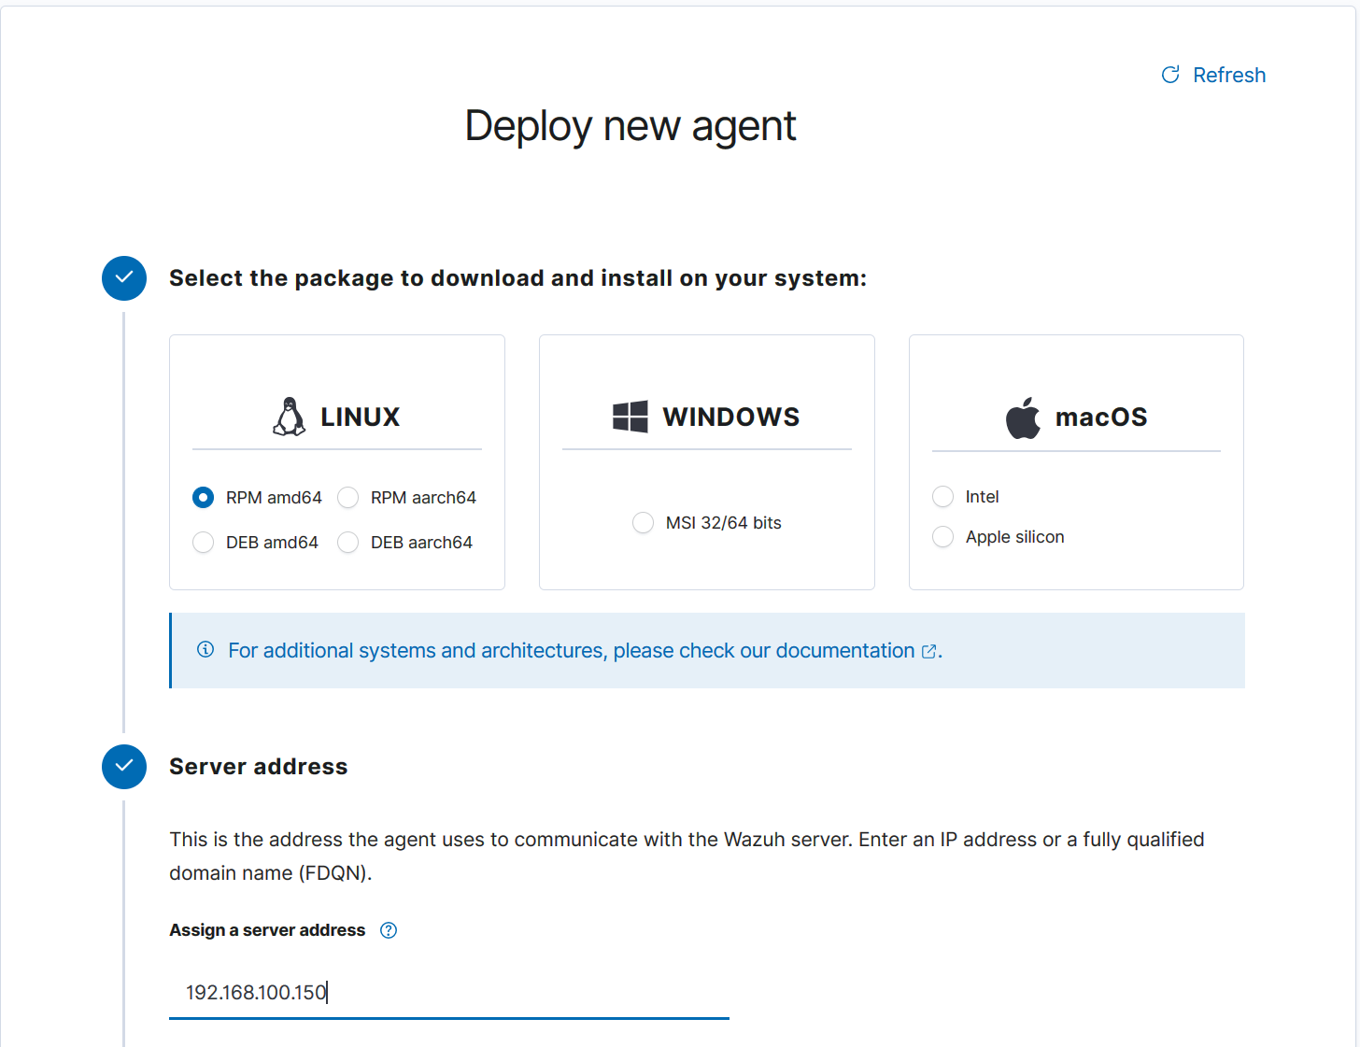
Assign a server address

Slide 10
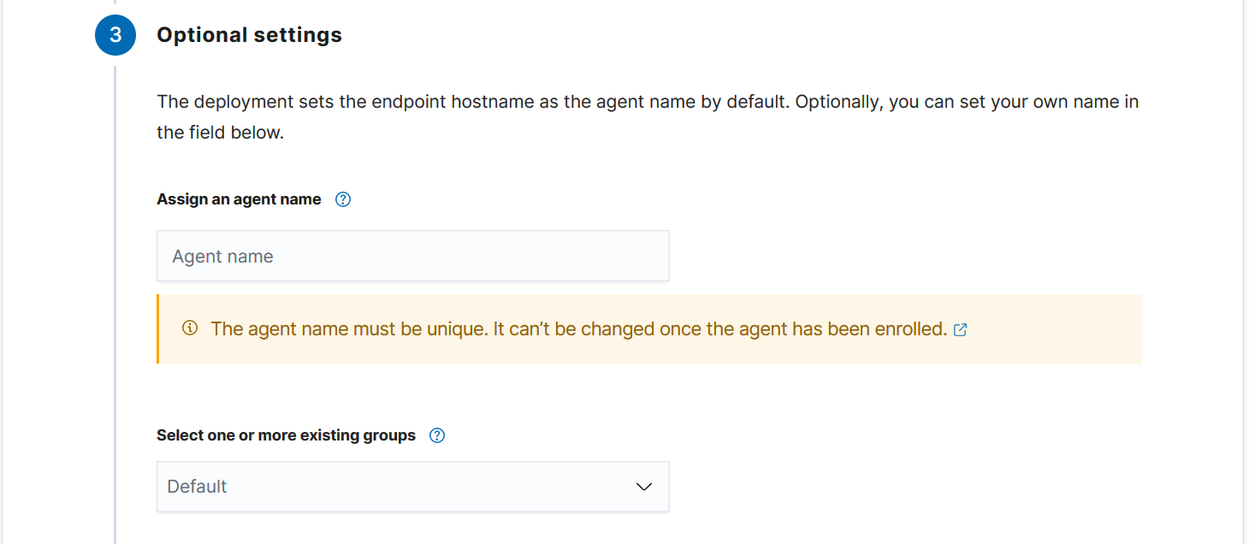
Optional settings 都不填

Slide 11
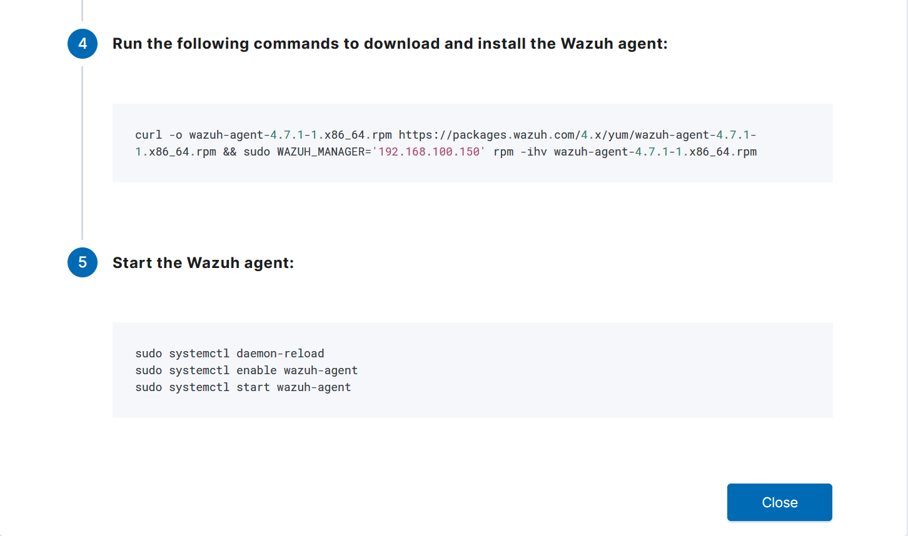
在 Agent Server 執行指令
wget https://packages.wazuh.com/4.x/apt/pool/main/w/wazuh-agent/wazuh-agent_4.7.1-1_amd64.deb && sudo WAZUH_MANAGER='192.168.100.150' dpkg -i ./wazuh-agent_4.7.1-1_amd64.deb
sudo systemctl daemon-reload
sudo systemctl enable wazuh-agent
sudo systemctl start wazuh-agent

Slide 12
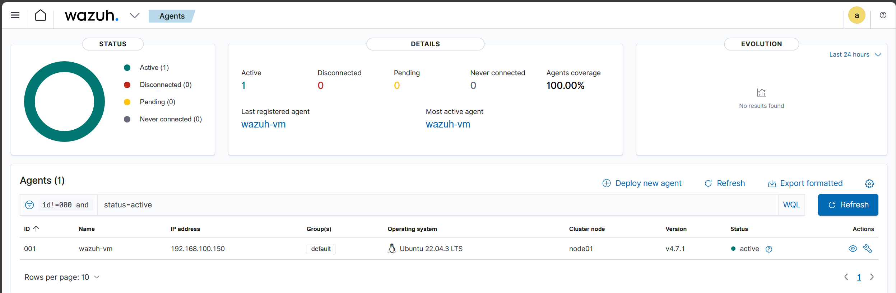
Agent 管理畫面

Slide 13
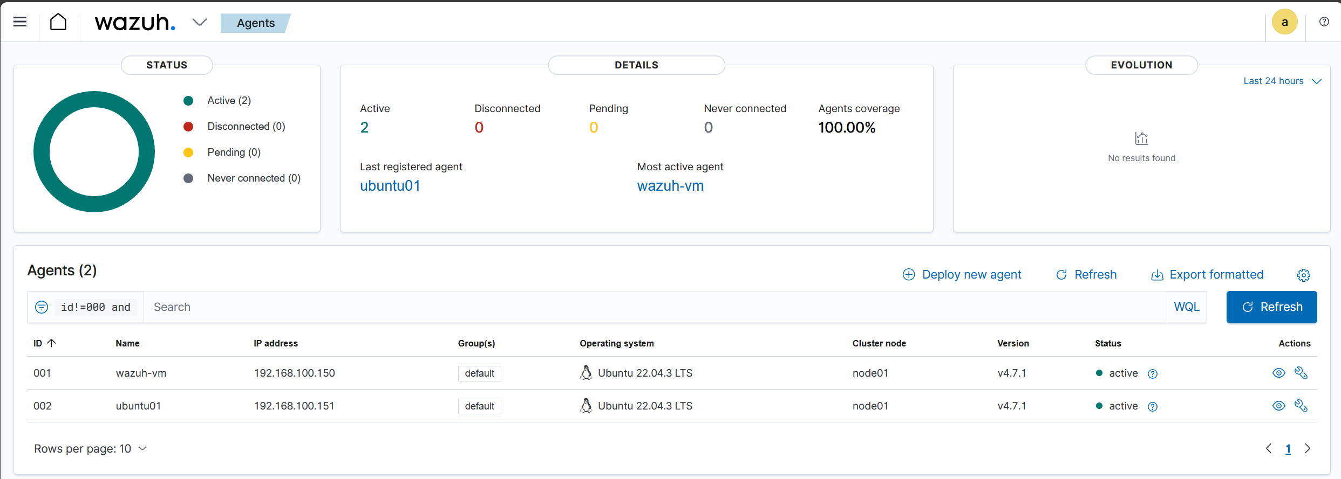
安裝靶機
安裝完後執行以下指令安裝 Agent
wget https://packages.wazuh.com/4.x/apt/pool/main/w/wazuh-agent/wazuh-agent_4.7.1-1_amd64.deb && sudo WAZUH_MANAGER='192.168.100.150' dpkg -i ./wazuh-agent_4.7.1-1_amd64.deb
sudo systemctl daemon-reload
sudo systemctl enable wazuh-agent
sudo systemctl start wazuh-agent

Slide 14
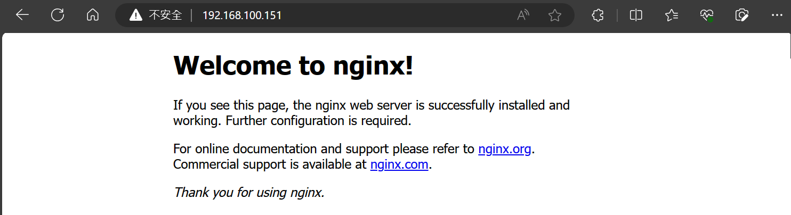
安裝 ngnix
$ sudo apt update
$ sudo apt install nginx
$ sudo systemctl enable nginx
$ sudo systemctl start nginx
$ sudo systemctl status nginx

